Slide 1

Smart Home Automation and Security System Project
Kassandra Moreno
CEIS101

Slide 2
Introduction
The goal of this project was to learn how to use Arduino and the basics of programming through building a home security system. While on the journey of building this home security system, I learned how to navigate around a breadboard and the basics of programming codes. The following slides will sum up my learning path through this project.

Slide 3
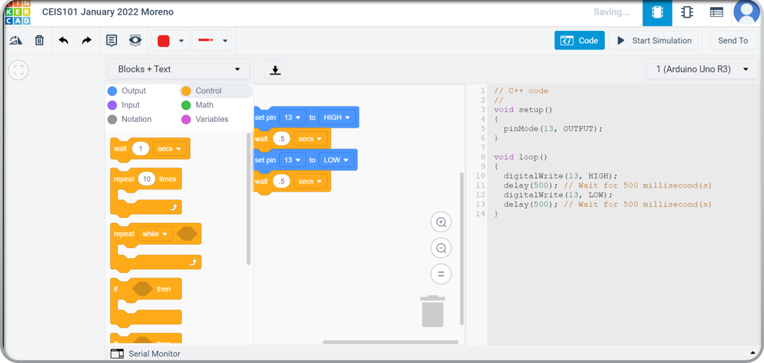
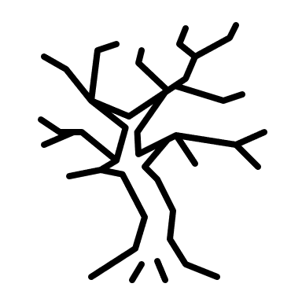
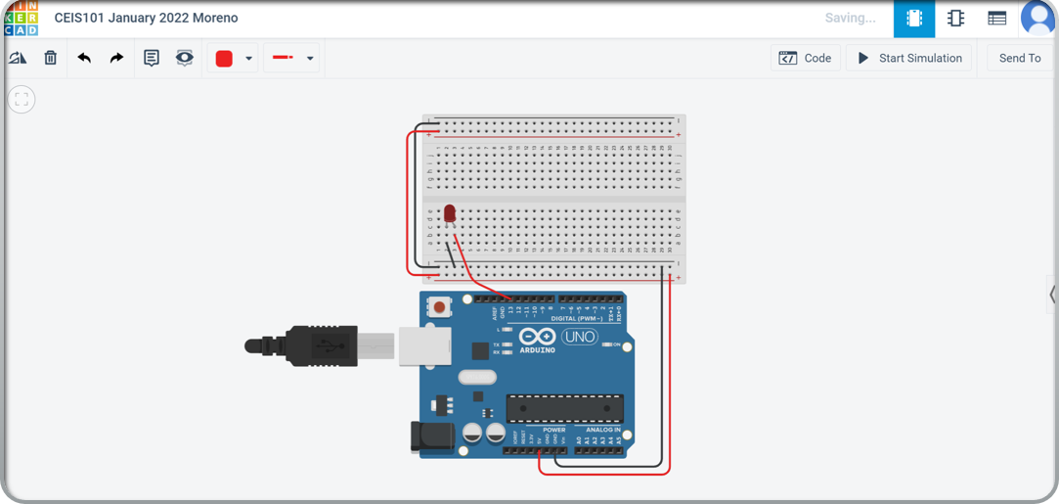
Arduino in Tinkercad
Tinkercad was a handy tool used during this project! This website allowed me to test out configurations online to prevent real-world malfunctions that could permanently damage my Arduino. I also really appreciated the coding breakdown. As someone who has never seen a code before, this was a great introduction to learning how my Arduino worked without the stress of damaging my physical Ardunio.

Slide 4
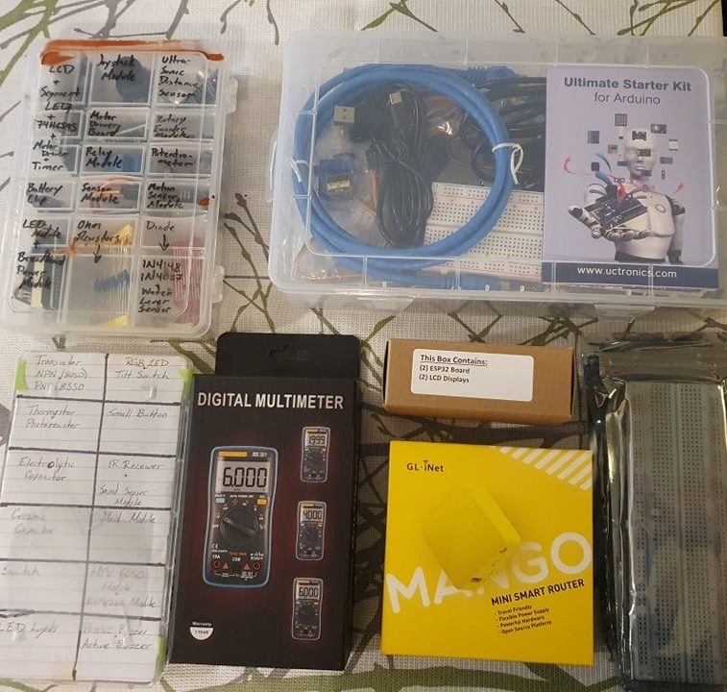

Bits and Pieces
UCTRONICS Kit
ESP32 (2)
LCD Modules (2)
Breadboards (3)
Mini Router
Patch Cable
Digital Multi Meter
USB to Micro USB (2)

Slide 5
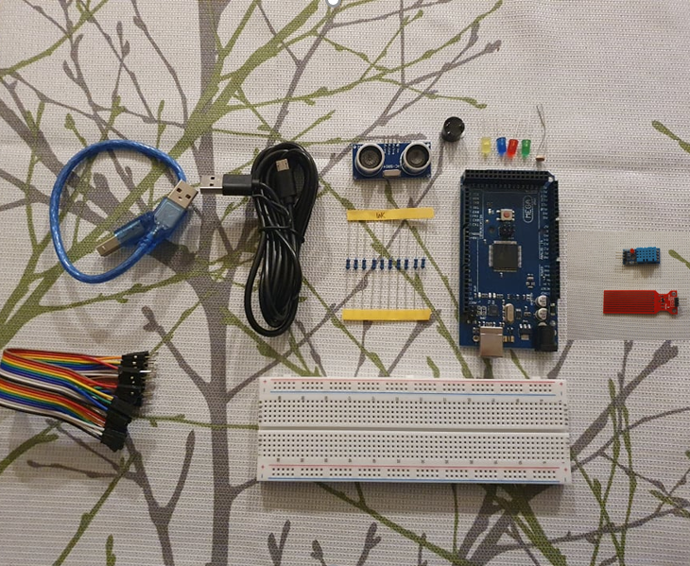

Project Pieces
Arduino Mega 2560
Breadboard
Resistor 10kΩ
LEDs
Ultrasonic Sensor
Active Buzzer
Photoresistor
Wires
USB Type B cable

Slide 6
Learning how to translate codes to understandable messages
Closed Door
Open Door
Serial Monitor Translation

Slide 7
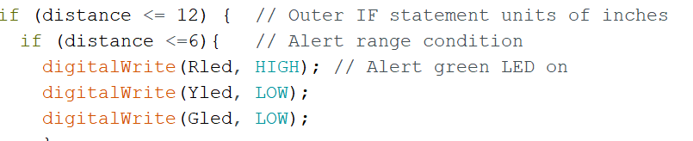
Learning how to implement ultrasonic sensor
Green Light
No Warning
Out of coded range
Yellow Light
Warning
Close to coded range
Red Light
Alert
Alert range

Slide 8
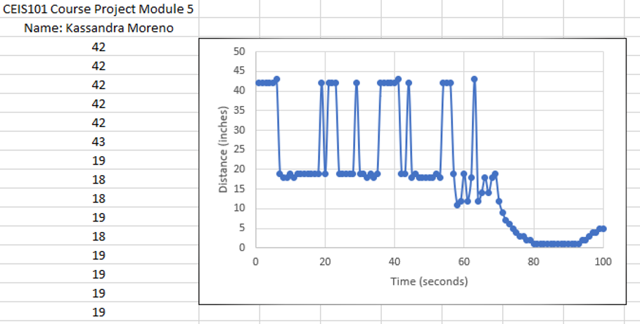
Plotting Security Patterns

Slide 9
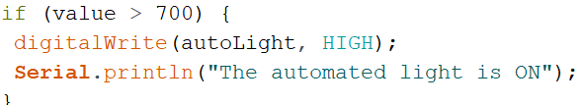
Automated Lights and Photocells
Photocell below 700
Serial Monitor
Photocell above 700

Slide 10
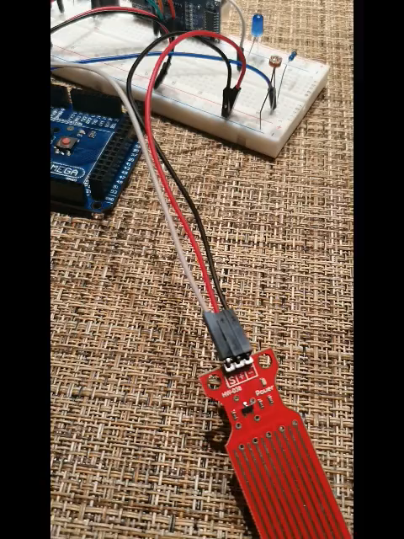
A Challenge
Incorporating DHT-11 and Water Sensor

Slide 11
Incorporating DHT-11 and Water Sensor
Water Sensor
Water Sensor and DHT-11 Interfaces
DHT-11

Slide 12
Personal Challenges
With this being my first time working with anything involving circuit boards and Arduino, I found myself quite challenged with understanding our given codes. I found the codes extremely intimidating because I didn’t understand the structure. I took it upon myself to build my understanding by making slight changes to see if I could manipulate the codes. I would say my biggest challenge would have been code manipulation. Though I haven’t yet become perfect at it, the journey has left me with a much better understanding of how codes work.

Slide 13
Career Skills
Ardunio basics
Wiring (ground vs power)
Coding Basics
Understanding automation
IoT (internet of things) in relation to P2D2 (places, people, data, and devices)
Different operating systems in relation to user purpose

Slide 14
Conclusion
The instructions given for this assignment were easy to follow after getting some professional insight from our live discussions. Project-wise, my hardest day was the first one since I had no idea how to put anything together or a true understanding of what I was connecting. After learning the basics (black= gound= negative= short prong; red= power= positive= long prong), it all became a matter of putting pieces in its place. I loved every challenge that came with this course, and I am eager to continue learning more!

